Slide 1
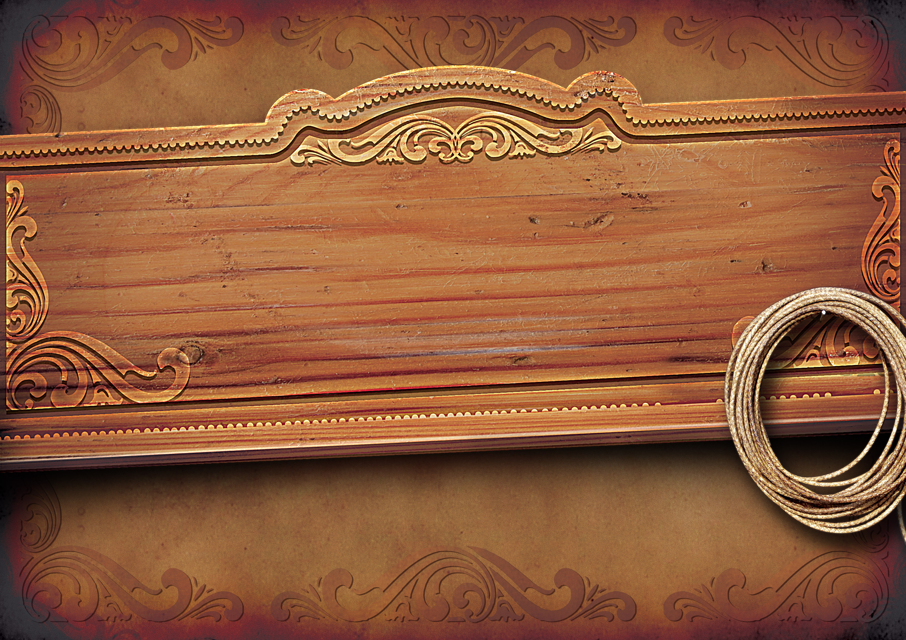


The good, the bad and the ugly.
2015
Notes:
Hello everybody.
The title of my presentation today is
[animation]
“The Good, the bad and the ugly”
I wanted to wear a poncho and stroll out chewing a cigar to sound of a distant Harmonica, but my Tech Lead said he probably have to shoot me if I did.

Slide 2


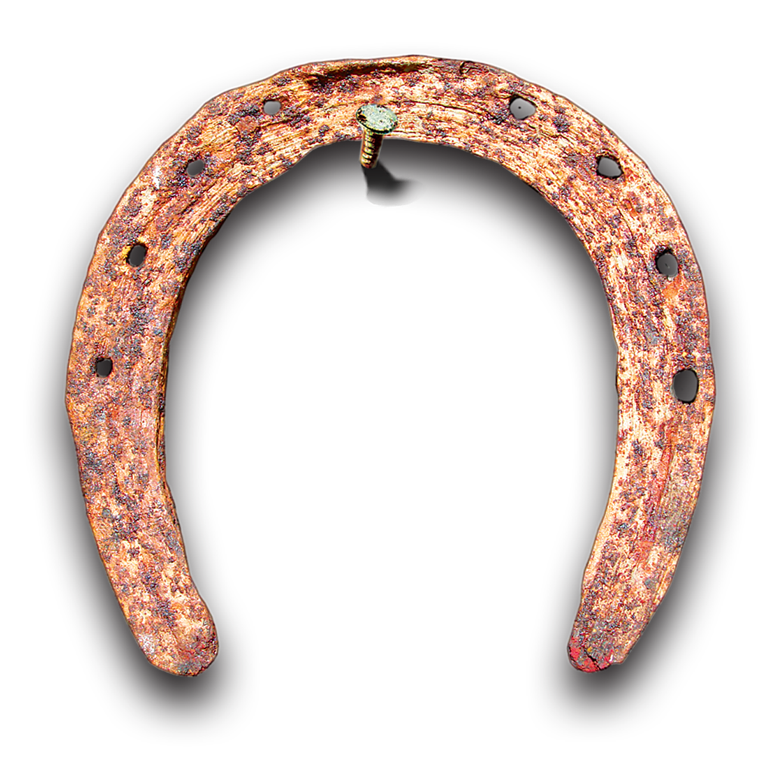


How node helped tame the wild West One
2015
Steven “Big Bucks” Atherton
Wanted for
Bad hair
Worse jokes
Notes:
Let me introduce myself, My name is Steven Atherton and I work as a Senior Developer in the Visual Journalism development team. We are based in New Broadcasting House West One, Our team works closely with journalists and designers to produce bespoke content for the News website like this…

Slide 3


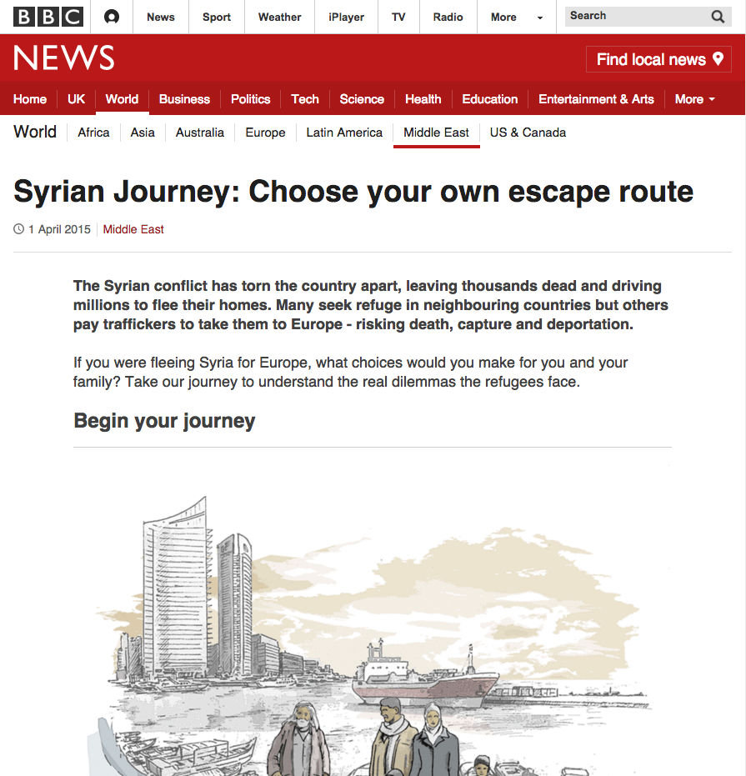
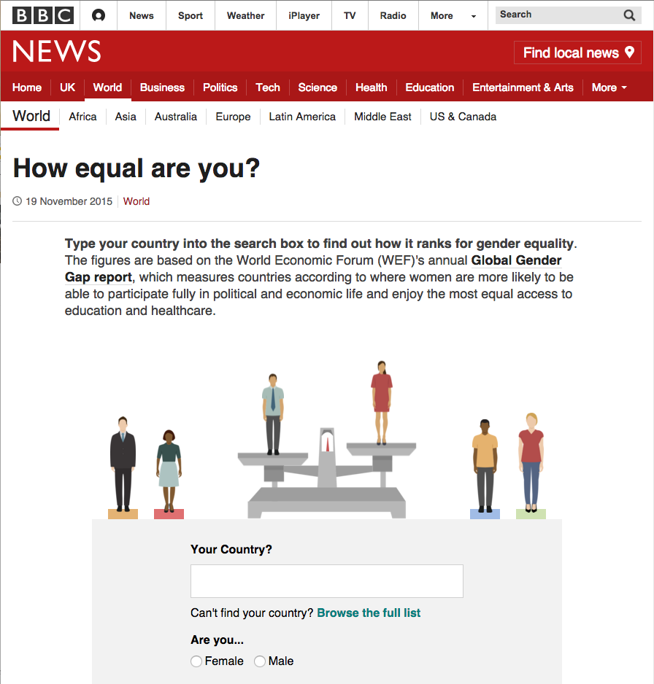
Bespokes
www.bbc.co.uk/news/world-middle-east-32057601
www.bbc.co.uk/news/world-34808717
Notes:
[animation]
An interactive story which highlights the challenges faced by Syrian refugees as they try to safely reach Europe,
[animation]
or this an interactive info graphic that surfaces data about the inequalities that still exist between men and women by making it relevant to the reader.
But that’s not all we do we also develop a selection of journalistic tools.

Slide 4

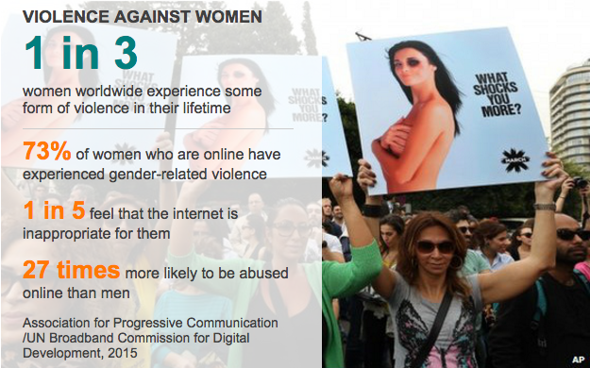
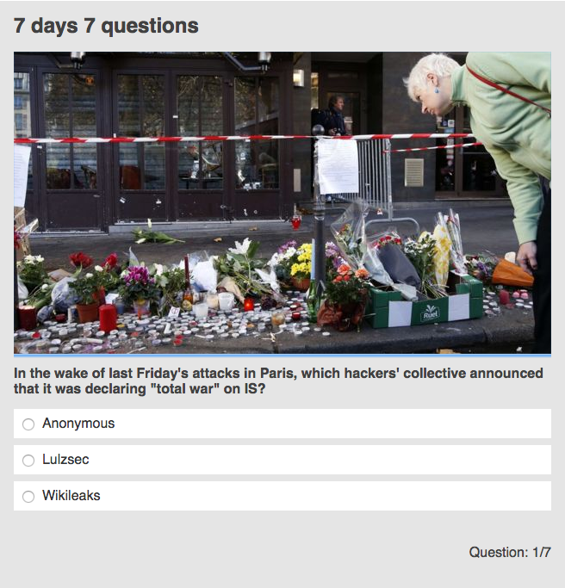
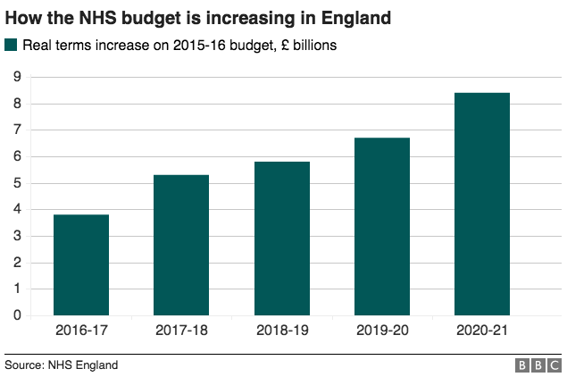
Tooling
DataPics
Quizzes
Datasets and Charts
Notes:
Tools that allow journalists across the business to produce enhanced content to go alongside their stories.
We have develop a toolkit which allows journalist to build these things for themselves through a web platform without developer intervention.. While this is currently on the forge… We aim to move it to AWS
[animation]
Such as mini Infographics that we call DataPics,
[animation]
Dynamic charts driven by JSON and CSV datasets
[animation]
And Interactive quizzes.

Slide 5
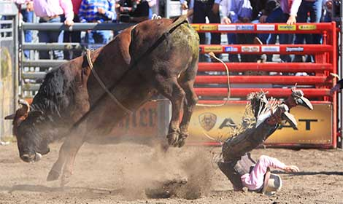
Caveat
We are relatively new to Node
That will teach him not to raise a Jira ticket…
Come to the BBC they said.. Learn to code the said!!
We fell off a far bit!!
Notes:
But today, I’m not really here to talk about those, like everyone else, I’m here to hear about node, and right now to talk about node,
There is one caveat though. We are not going to pretend that we are node experts
[animation]
We are still learning, and still refactoring. We hope by the end of the day to have picked up quite a few tips from everyone else here.
So I wont talk to about really technical stuff like benefits (or not) of prototype versus classical inheritance, Or complain about how JavaScript is quirky. I’m not going even mention the lack of type safety,
Because I suspect you guys know all about that.

Slide 6
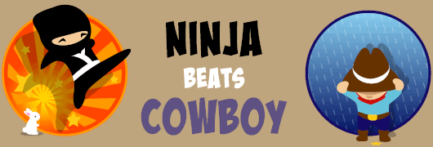
The Journey
From Client side cowboys
To full stack Ninjas!!
Notes:
No today I’m going to tell you a story, a story about a journey, it was a journey that was fraught with dangers, where we came up against seeming impassable barriers, we encountered desperate bandits. And at times we wanted to turn around and head back to safety. But we didn't.
[animation]
It the story of our journey with node.
How node was instrumental in transforming Visual Journalism from seat of the pants client side cowboys,
[animation]
Into full stack software engineers working in the frontier country (or as we call it AWS).
I’ll tell you about some of our successes, and the things we have learned.
Its already been quiet a long journey, and one that still isn't finished,

Slide 7

Background
We’ve always been JavaScript Developers
But Responsive web design was here…
Notes:
But like all good stories we need a prologue, a little bit of background to put our adventure into context.
[animation]
The Visual Journalism team was born out of the ashes of the News Specials team in 2012, for those of you that may not have heard of the News Specials, they were a bunch of Client Side Developers embedded with journalists, that had somewhat of a double barreled reputation:
On the one hand:
We produced great bespoke interactive content similar to the ones I showed you earlier, which enabled editorial colleagues to get across complex ideas to our audience.
On the other:
We produced lots of ad hoc code we we then injected into at will into the BBC News website.
Back in the day that was ok, almost all our audience views the site on fast connections using fairly powerful desktop machines, but everything was about to change...
[animation]
It was the dawn of a new age… Responsive web design had arrived… and it meant change…

Slide 8

The Ugly
Wanted for
Brittle deployments
Notes:
The Ugly - I know, I’m going backwards but
The Ugly the bad and the good, wouldn’t have had the same ring to it
Before responsive web design we produced content like this..

Slide 9
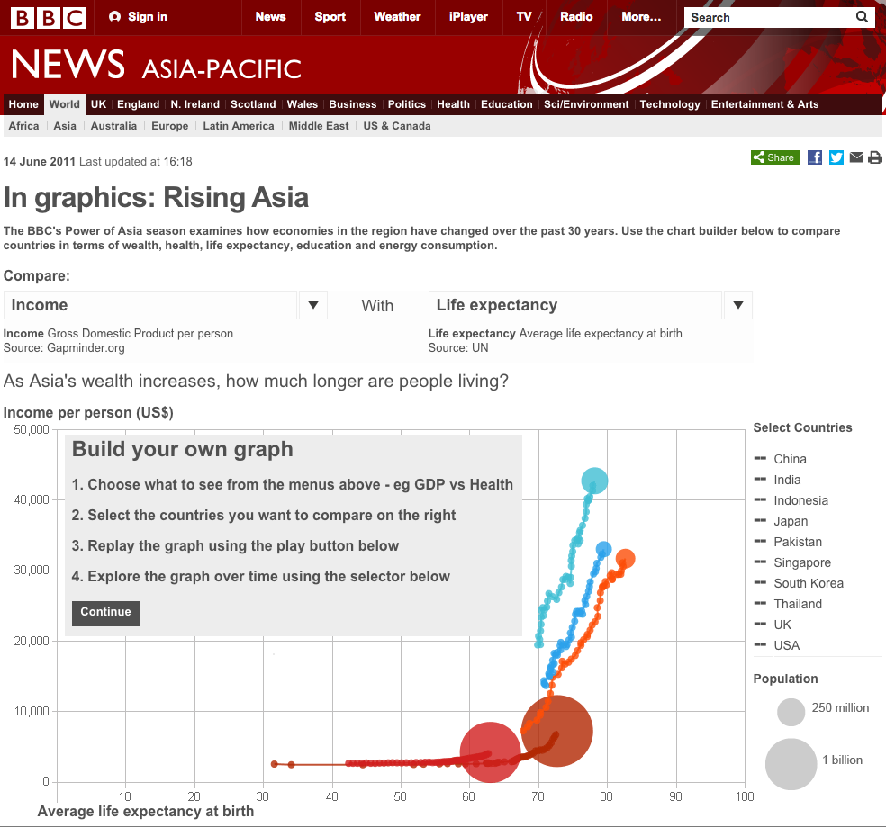
2012
Not minimised Smelly code
Difficult to maintain
Overly complex CSS
Desktop only
http://www.bbc.co.uk/news/world-asia-pacific-13746908
Notes:
It look nice and was highly interactive, but under the hood it was “Ugly”.
There were lots of things we didn’t do..
We didn’t minimize our code, Because we didn’t worry about bandwidth..
We didn’t sniff our code or code standards, Because tight deadlines made it difficult to implement..
We often used one huge JavaScript file, which only the developer working on it could properly understand..
The same could be said for CSS, with added complexities of having to deal with slotting into a page we didn’t control.
Our work was not even delivered to the mobile platform, or the new Responsive News site.
[animation]
As more and more people consumed the news website via a mobile platform more and more people were not seeing our hard work.

Slide 10
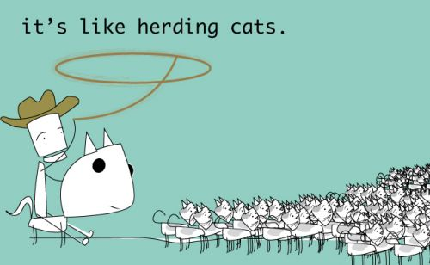
Incompatable
Forcing our content into a dynamic changing platform
Notes:
We couldn’t just drop our content in, the user experience would be terrible:
Unminimised code..
Multiple HTTP requests..
Image that were not optimised
none of this was good for the mobile platform.. not to mention integration hoops we needed to jump through to get our code to even show up inside Responsive news pages.
Responsive News was an agile project
Every fortnight they would issue a new release, every fortnight all our content had the chance of breaking.. And it often did… so we would fix it, and then fix it again, and again… and again…..

Slide 11

Tooling up
Node makes tooling easy.
First generation of tooling got us deploying to RN easily.
Anticipate the difficult by managing the easy.
Lao Tzu
The next generation of tooling would do something unheard of
Notes:
So we needed a solution, we need to tool up:
But back in 2012 I was green, fresh faced new developer…
It needed a solution that was easy to build, but also easy to maintain, and most all easy to use...
Enter Grunt:
Ok everybody here knows about Grunt, it old news now I guess, but there was some reasoning behind why we chose it:
It written in Node and node is just JavaScript right?
that's it, that's the reason we chose it… But to expand on that.. Because it is written in Node it seemed easy to us, not that writing Node code is necessarily easy, but the barrier of entry was low.
[animation]
Easy for a new developer to write a project scaffold.
Easy for under pressure CSD’s who normally only have two weeks to deliver each project.
It would need minimal set up, offered a shallow learning curve
And would be easy to adapt and extend.
[animation]
So first generation project scaffold was born and it was an instant sucess...
within a few weeks we were delivering most of our bespoke content to both the old Desktop platform and the shiny Responsive News platform.. from the same code.. in a state that didn’t murder a mobile browser.. Big cheer..
We didn’t stop there...
[animation]
Because it was easy we carried on and were to solve even bigger problems…

Slide 12
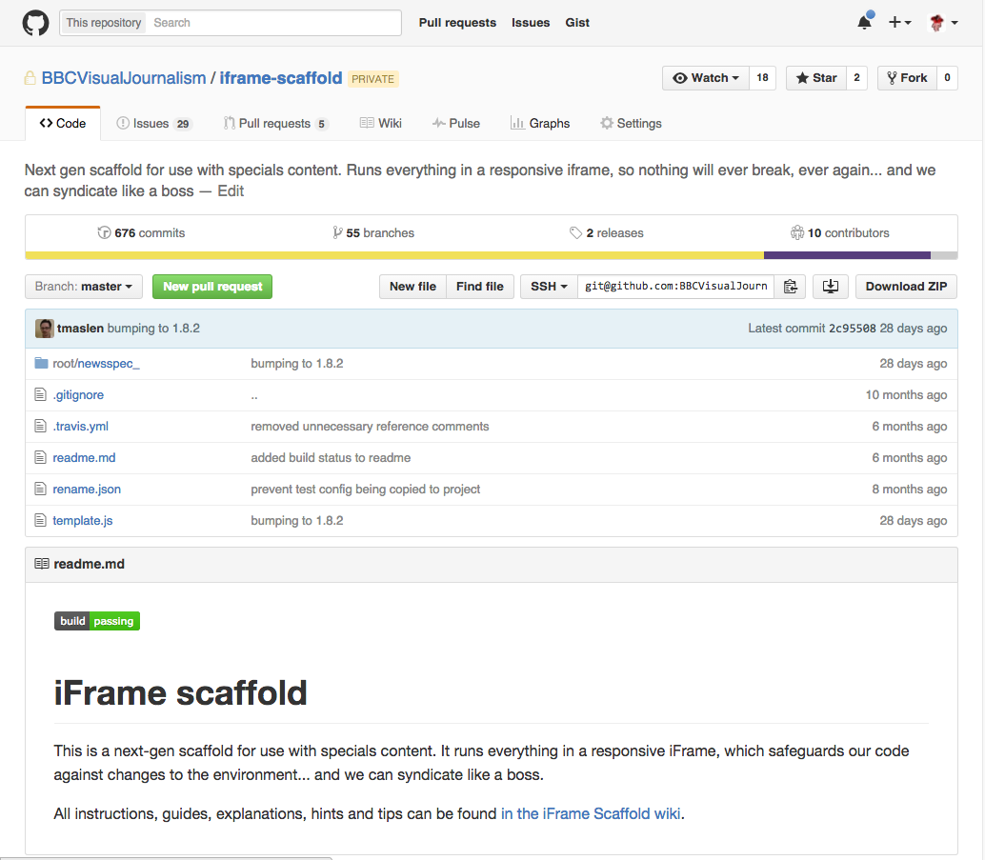
Make it so
29 Languages
French, Hausa, Kirundi, Somali, Swahili, Kyrgyz, Uzbek, Burmese, Chinese, Indonesian, Thai, Vietnamese, Bengali, Hindi, Nepali, Pashto, Sinhala, Tamil, Urdu, Azeri, Russin, Turkish, Ukrainian, Welsh, Portuguese, Spanish, Arabic, Persian and English
Notes:
We built a next generation project scaffold.
The next generation scaffold put all content inside a responsive iFrame. We think we might have been the first people to do that properly. We can put just about anything in an iFrame, and our developers pretty much do..
Node with Grunt means that we have abstracted away all the hard stuff, but we have been able to do it such a way that it is not a “black box” solution.
Our developers just build their bespoke, they make it look how it should and it can be included anywhere, it will fit into whatever width it has and behave like a proper responsive element.
Everything is clean and tidy, all our projects are structured the same way,
One developer can pick up another developers project and know where to start.
And if the developer needs to do something new or different.. They can dig into the scaffold quickly and just do it…
But here is the clever thing: the thing we love the most..
[animation] We can deliver all our bespokes to all 29 languages from one code base!!
Because we wrote this:

Slide 13
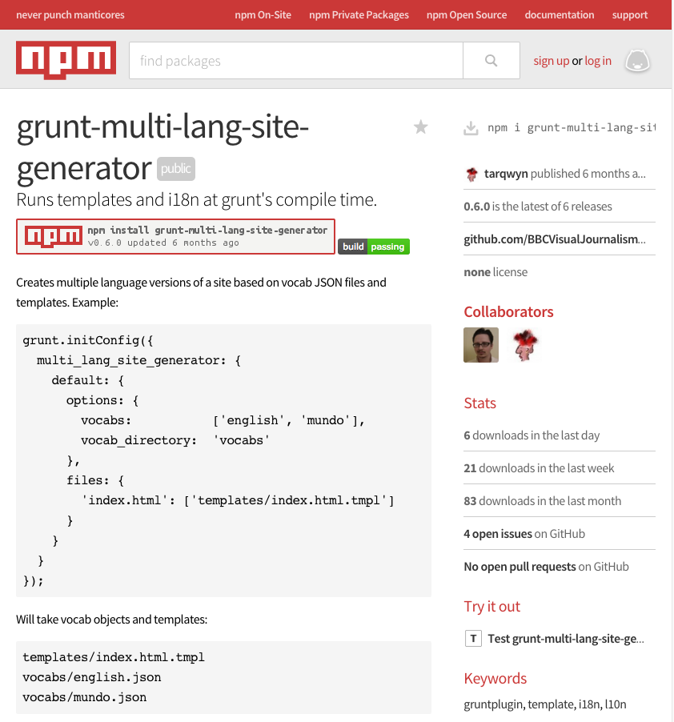
Like a Boss
Our first npm module
We went Open Source
Notes:
Using node we were able to turn the process of porting our bespokes to our World Service colleagues into a simple task, all we need was a translation matrix
This was a process which previously would require weeks of developer work and would often be fraught with pain, now came almost for free…
And finally the decision whether something should be made for our world service audience is now a purely editorial one.. With next to no technical limitations, This is exactly as it should be..
The Downside….
Of course our scaffold is big now it does a lot for us and maintaining it requires input from all our team… But because its node we all can, and because its node new team members can contribute straight away…
It has transformed our Ugly code and it has improved our Ugly workflow, our deployments are no longer brittle and can be used just about anywhere.. Including our syndication partners **** Add example ***
Our first toe into the Node water was a sucess

Slide 14

The Bad
Wanted for
For doing dangerous things easily
Notes:
So we had an early success when we first adopted node. We got a bit node happy.. I mean what's not like? We were loving it. So node became our go to scripting language… So when presented with a thorny problem we turned to node to help solve it..
Why is this Bad?
Its not, not really, but will need to explain..

Slide 15
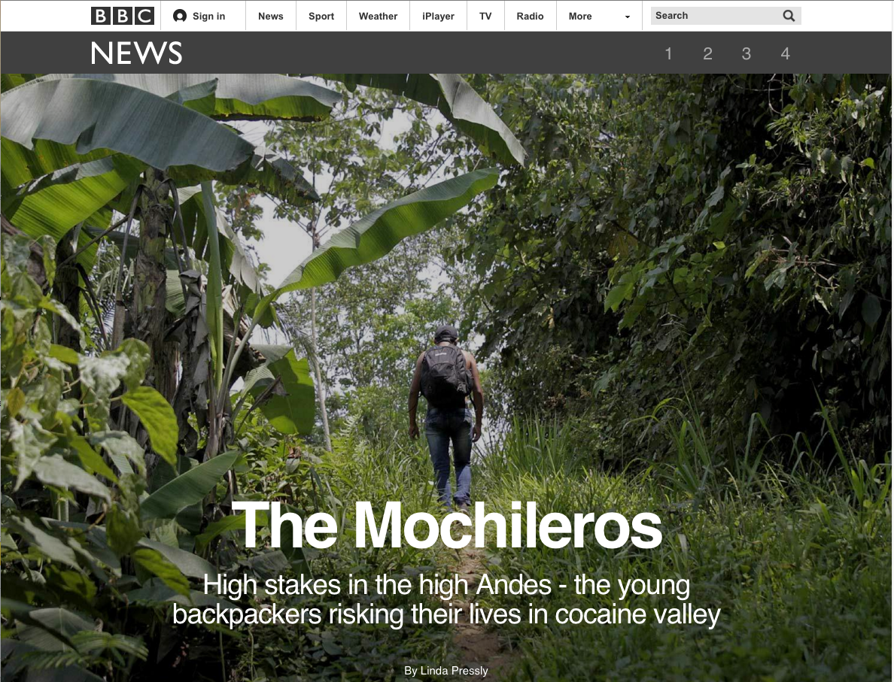
It doesnt fit.
Notes:
Some of you may have seen these LongForm pieces on the BBC News website.. They look pretty awesome right?
[animation]
We can’t take credit for them though, they are produced by a third party tool called Shorthand which is used by the journalists to author HTML/CSS and JavaScript.
Here in lies the problem..
We were asked to integrate that authored content on the BBC news site.

Slide 16
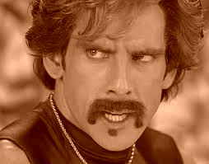
Orbify!
Shorthand is used to being the boss…
You can’t be my boss! Nobody is my boss! I’m my own boss! I created myself!
Notes:
Or in other words we were asked to shove whole static pages into a dynamic platform without breaking one or the other or both!!!
We start out with...
Shorthand Is designed as a full page content where its the only thing on the page.
Once generated by the the tool its a flat static page… with some CSS and JS files..
[animation]
Shorthand works because it’s the boss, it scroll animations, sticky navigation, video chapterheads etc. all work because it’s the only thing on the page.
And the they know how it will perform

Slide 17

Cleanup
We needed to cleanup shorthand
and make it play nicely with Orb…
We needed ensure that it followed some “house” rules…
Notes:
We want to clean up shorthand and make it work inside a BBC branded page and play nicely with ORB.
[animation]
We need to make sure it adheres to basic BBC rules..
We need to give absolute asset paths with the assets behind a cdn,
and we need to implement SMP for videos and remove the shorthand video solution
and we need to add Share tools
and onward journeys..
and iStats
and Chartbeat
and we need to do some checks to see if the code has security vunerabilities
Oh and after we’ve done all that
We need to put it inside ORB
And we have to be able to repeat this quickly with limited developer resource.
Were we scared… Hell No…
So we off we went..
Armed with node..

Slide 18
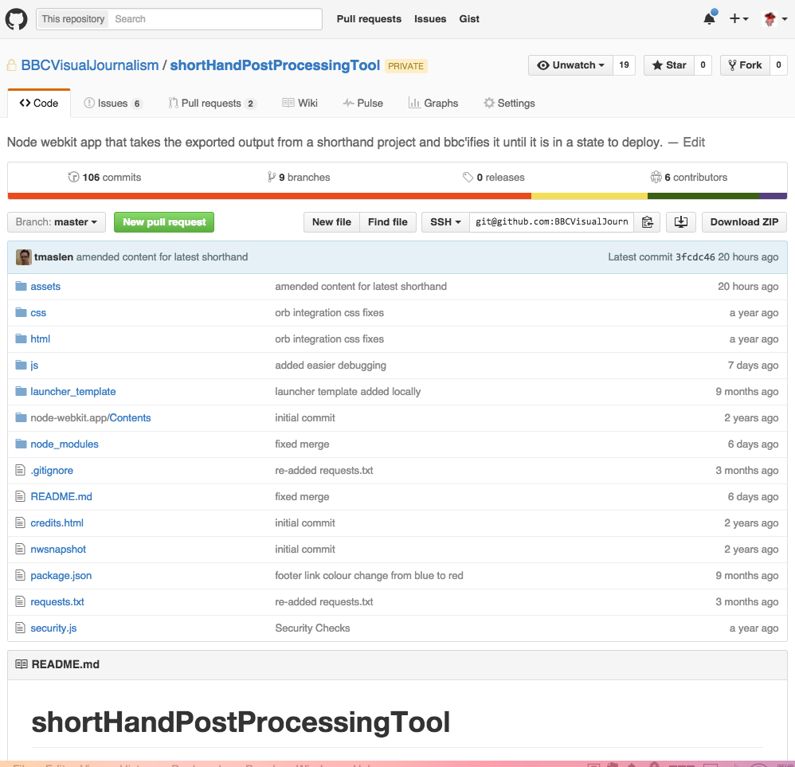
SPPT?
Notes:
We built a tool to do it all for us…
[animation]
We called this the shorthandPostProcessingTool.. Because it’s a catchy name obscure name…
We wanted to take advantage of the asynchronous event driven nature of node so we tried to implemented the simple Finite state machine paradigm as opposed to a more traditional threaded approach.
This is something that node lends itself to quite well

Slide 19
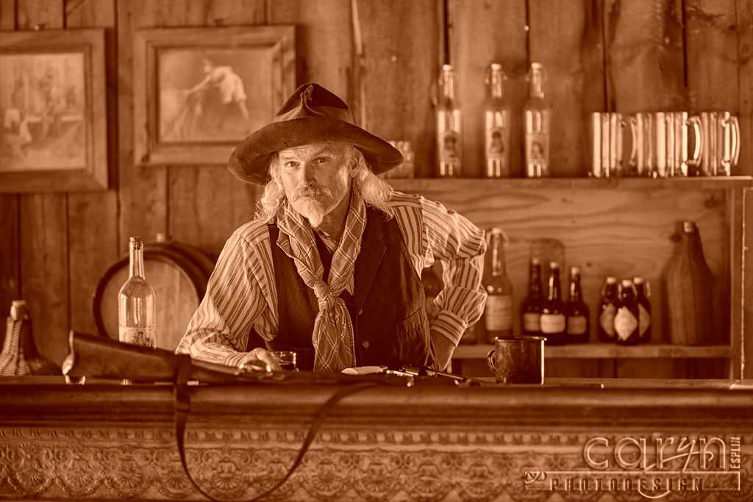
Its like a Saloon
What can I get you cowboy
I hear those Visual Journalism guys pack a mean punch..
Each cowboy has to wait for the next cowboy to be served…
We have a blocking barkeep…
Notes:
But what do I mean by a Finite state machine..
First we need to think about the event driven model
[animation]
Anyone who works with me will tell you I am sucker for an analogy, so here goes this is my attempt here..
So we have a saloon, the barkeep takes an order of beer, and a plate of Chili, he takes his 2 bits payment he then goes and grabs a beer once he has the beer he wonders off and dishes out the chili. He then returns with both the chili and the beer to where the hungry cowpoke is waiting and gives them to him.
[animation]
He then turns to the next cowboy and takes their order and so on. This works well enough and to serve more cowboys we just need to add another barkeep to double the amount we can serve.

Slide 20
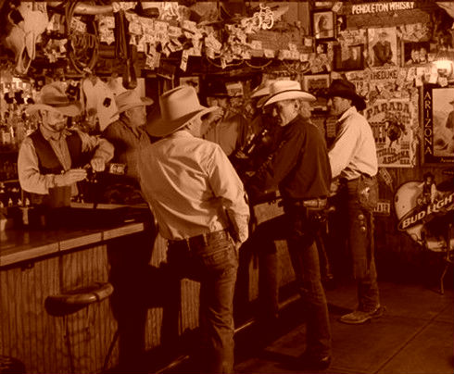
Cattle drive!!
Alternatively a non blocking saloon
Yeah, fruit punch…
The cowboys order is dealt with quickly
Getting the order ready doesn't’ stop us serving the next cowboy
Notes:
But what happens if an entire ranch of cowboys show up while they are on cattle drive,
[animate]
If we need to scale up without increasing the number of barkeeps linearly, for this we can use an event driven saloon.
So now we have a cashier who takes the order, he passes the drinks order onto the barkeep and the chilli order to the cook, meanwhile he takes payment. And moves on to the next customer.
[animation]
At some point both the drink and the chili are ready and can be handed it to the cowboy (this is our callback). The key point here is that getting the order ready is a non-blocking function. Non blocking functions are key to a successful event-driven system

Slide 21
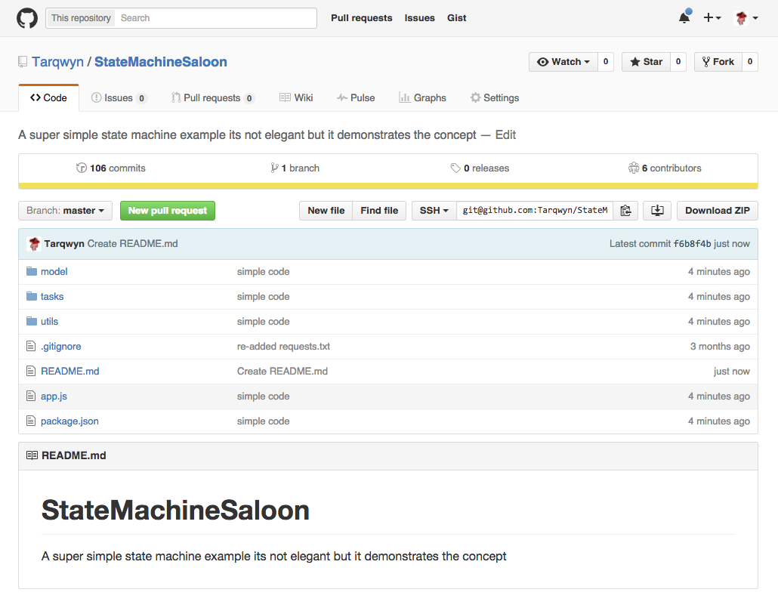
Sample saloon
I made an example….
This quick and dirty example shows one way to implement a Finite state machine
There are some libraries too..
Checkout npm
Notes:
A state machine is an abstraction of an event-driven model. An event-driven state machine is like someone with amnesia who constantly needs to ask
Where am I?
What just happened?
What next?
In a Finite State Machine (FSM), you let your state machine know “where it is” and “what to do I do next?”. By defining a finite list of states your system can be in
and the events that can occur,
and functions which are triggered by events
which in turn drive state transitions.
Then you start up your main loop and away it goes.
My quick and dirty example works via keyboard input events and only has one model, but this can just as easily be events being received from an external source on a number of model instances or orders.
The concept of the FSM is important in event-driven programming precisely because it makes the event handling explicitly dependent on both the event-type and on the state of the system.
However we soon learnt that it can also add a level of complexity to an application that makes a project difficult to maintain and understand what is going on if not very carefully designed
As requirements changed the PPT tool got harder to refactor.. Adding new states while technically not hard, added complexity, removing a state meant heavy refactoring too…
We decided this approach was probably overkill for the problem we tried. But on the plus side we learned a lot about how node works with an event loop, and how we can represent a set of complex rules and conditions.
But we wanted to find an easier way…

Slide 22

The Good
Wanted for
Killing complexity…
Notes:
So the BBC is moving into AWS. Visual journalism has to follow suit, actually we need to move quick..
Historically we have used an old static stack to deploy our bespoke content, we FTP directly to this stack.. But the move to Responsive News means that this stack is going to be turned off sooner rather that later. AWS and S3 gives us a viable solution to this.
We can store all our static assets in s3 put them behind a CDN, but we need a way of getting the content into s3
We cant just drop it and hope for the best…

Slide 23

Small is good
Node is ideally suited to small jobs
Micro Services are an excellent way of cutting the Elephant up into easy digestible chunks
Wat’cha chatting about
Notes:
So when we built the Post processing tool it didn’t take long for it to get big and complex, and it was not even that complex a job it was doing but JavaScript does not take long to get messy if you just keep patching and changing it, and while a refactor will always help, that often fills even the most perfection obsessed developers with dread.
We didn’t want our next node applications to suffer the same fate.
I then remembered something I was told many years ago by my first boss..
[animation]
He said to “Son, if you are going to try to eat an Elephant don’t try to swallow it whole, your first job should be to chop it up into chunks”
[animation]
The idea behind micorservices is to chop large scale applications into small, independent processes that can communicating with each other using language-agnostic APIs. They tend to be highly decoupled and focus on doing a small job really well

Slide 24
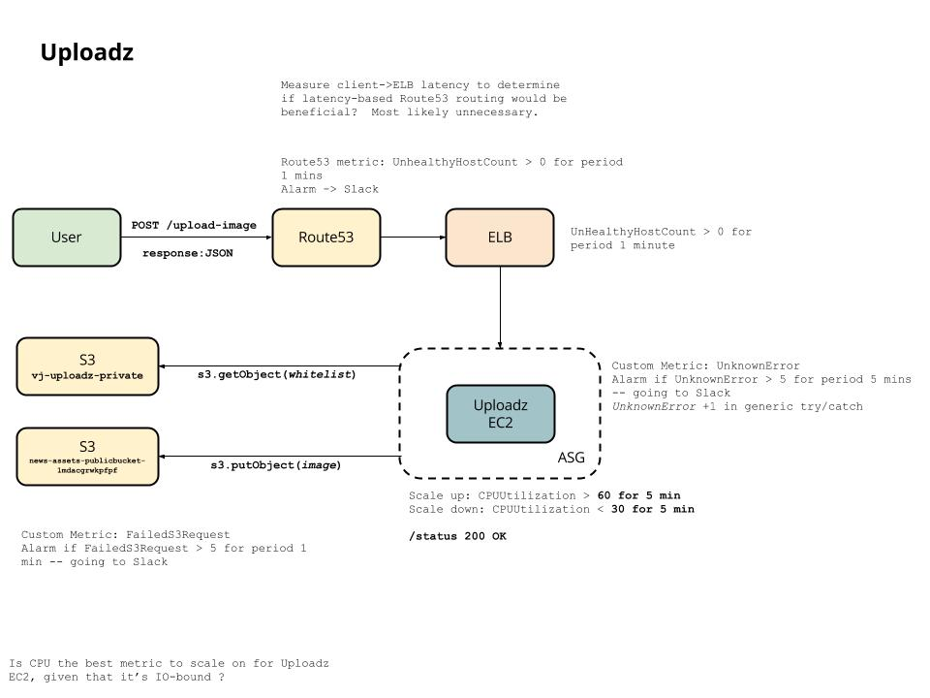
Microservices
AWS means we can deploy tiny services
Notes:
Node is great you can do quite a lot in Node with not a whole heap of code..
Node also encourages the practice of composing an application from smaller modules, with each module hopefully being highly cohesion and loosely coupled. Not that this is exclusive to Node, but it just seem natural to the language and the whole node eco-system.
And what's more having access to AWS really helps, We are able deploy each service independently it just makes the whole thing just seem so much more manageable

Slide 25
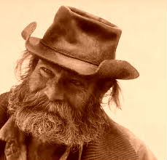
Noobs
Hey green horn!!
We talked the talk…
We walked the walk…
Now lets see if we can ride the stride….
In my day you had to code in Perl, while riding your horse and branding a steer
Notes:
But we were noobs
[animation]
We hadn't built anything in AWS, and we had never designed and built a service before..
[animation]
Ok we had built a the Indepth Toolkit on the forge platform, but we hadnt really needed to worry about the platform itself, we were just tenants.
It raised a few questions
How did we scale and cope with concurrent users requests?
How did we handle Security?
How did we log our application?

Slide 26

Getting started
We had few problems to solve
But I has l33t PHP’s
It’s not that I’m smart, it’s just I stay with problems longer.
Albert Einstein
Notes:
The first problem was concurrent users..
So we knew that node supported thousands of concurrent connections, in fact it was more likely that the linux systems we were going to host our applications on would hit there normal 1024 open socket ceiling before node would worry about it..
So that was not an issue in of itself..
So node was a good solution. Then..
So then we had to think about how our users would be authorised…
Well we got certificate information for free using the Node version of the magic built tool.. So we could whitelist our users via there e:mail and then allow them to use the service if the were OK..
But we’d need to make a request for the whitelist.. Because we wouldn’t keep that on the EC2 instance, check the user against it, if it was successful we would then process the request push the file into s3 wait for s3 to respond, and then either tell the user the path.. Or why tell them the request failed… Oh and we would need to check that the file was an image.
That’s a lot of responses we need to wait for and a few states we can be in…

Slide 27
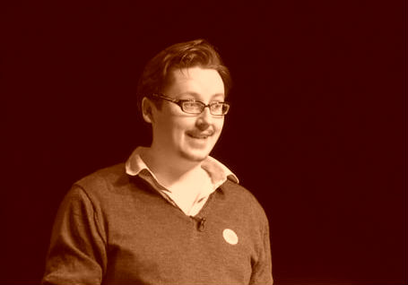
First go…
Callback hell…
573veN y0ur @ 8aD pR0gr@Mm3r, I d0N7 unDeR$7anD 7hi5I
Notes:
An we wanted each thing to be as loosely coupled as possible…
Our first attempt had lots of callbacks within callbacks… we struggled with scoping between modules and though it worked we were not happy with the code…
[animation]
Our next attempt we decided to implement Express,
Express is the lightweight web application framework written in node – A bit like Zend but not as sucky…

Slide 28
Try again
We solved scoping with Events
You see, in this world there's two kinds of people, my friend: Those with that node and those who make tea. You make tea.
Notes:
And we added events, now applications would fire off requests and wait for responses. This helped with scoping, and made for less callbacks… And was the node way… But it still seemed overly complex.
So our next attempt we used lodash to merge a properties we were interested in being passed around the application. This got rid of scoping issues and made our callback easier to follow, the whole thing was easier to understand.
We thought we had cracked it… We had low complexity…or so we thought..
But no we still werent completely happy…
The someone said “Promises”

Slide 29
Third times a…
But we cleaned up with Middleware
That Steven he’s a dirty rotten Perl coder… I’m telling you… I saw him coding Perl just last week…
Notes:
The next refactor we pulled out the lodash merging, and implemented promises… and then it dawned on us…
Express… is all about middleware…
In Express middleware is any number of functions that are invoked via the routing layer, before the final request handler is called, sitting in the middle between a raw request and the final intended route.
why don’t we just use that, pass our authorisation request through an authorisation middleware module.. And so on…
In each individual module we implemented promises.
Thus our final solutions was born..
We think its quite simple, quite clean, and very micro..

Slide 30
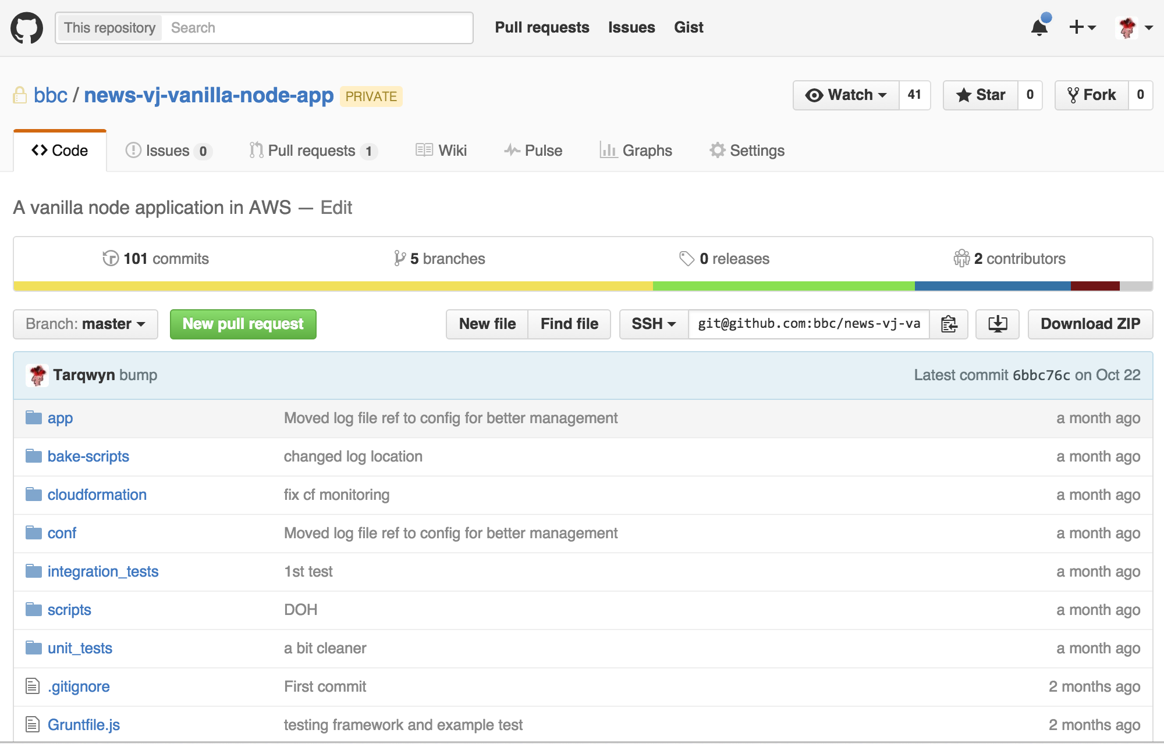
The finished product..
It might be vanilla, but it is still tasty…
Notes:
So we had a simple service that supported many concurrent users, it was secured via HTTPS with users whitelisted against there desktop certs..

Slide 31
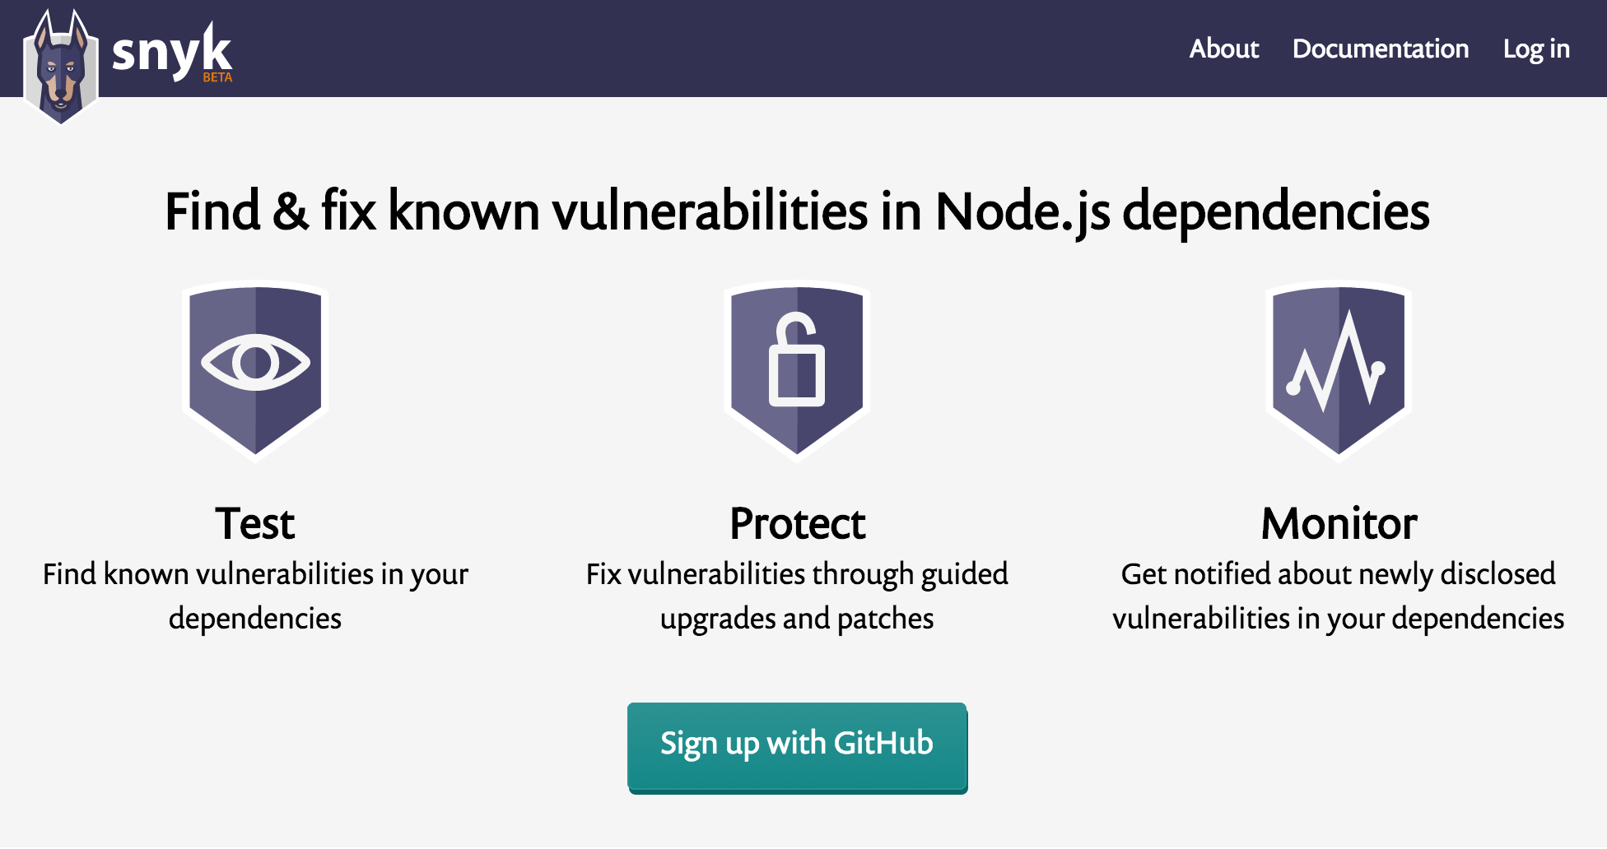
Stay safe
But is it safe…
Notes:
Except we were using libraries, and we had no way of knowing how secure those libraries were.. What vulnerabilities they might have, and we were essentially deploying this code as first class citizens
Then as luck would have it we came across Snyk.io
Snyk.io is an npm tool which you can use to test your code for known vulnerabilities, by traversing your dependency tree it is able to report back to you if it has found anything shady, and can even automatically patch them for you.
By simply adding this to our build process we are able to be more confident that the code we deploy is safe.

Slide 32

Chill
Log all the things…
You done good my friend, now let me see you deploy that thing…
Notes:
So then we need to log and monitor our application
We particularly wanted user metrics from different parts of our application..
Who used the system..
What they uploaded
Who might have tried to use the system and was denied
For this we used winston.js to push out logs.. What we like about winston its how it supports mutiple transports.
A transport is essentially a storage device for your logs. Each instance of a winston logger can have multiple transports configured at different levels. For example, one may want error logs to be stored in a in one file, but all your metric data in another.
We can then configure our application to take these different logs from the EC2 instances and push them to separate locations in s3..
Making them easy to manage
Once we were happy with all these approaches we built a vanilla version of our node microservice which we could reuse everytime we need a new one.
And we have to say we are really happy with the results..

Slide 33

The Journey over, but the adventure is just beginning
Be bold
Node likes scale
There are a lot of things we havent mention, which you can do in Node.
The Event loop means we can focus on functionality
Be brutal
HERE IS WHAT WE LEARNED
Think small
Its also east to write bad code don’t be afraid to start again.
Node makes a great platform for writing microservices
Starting Node is easy
Code Node
It has a low barrier to entry.
Everybody else is
Notes:
When we started on the journey we made JavaScript in the browser, we had no tooling, everything was hand cranked, through the last few years we have tooled up writing our own bespoke tools that we can all contribute to, We’ve had successes, and a few failures and learned from both. We are now deploying micro services to the cloud with Node, which will continue to power what we do for the foreseable future..
And in the future we plan to move our Indepthtoolkit into the cloud… and although we have not decided on the details, we know Node will play some part in that..
[animation]
So what are the key things we havve taken away from our journey..
[animation]
Node is an easy language to get started in, most developers, regardless of their background have done some JavaScript work, either at work or on personal projects. The jump to basic node development is not that hard… You can start like we did with tooling. Grunt is useful, or maybe Gulp.. Or just straight node with a few modules…If you need to script something try node get a feel for it.
[animation]
Getting your head around Asynch can be a bit annoying to start, creating the pyramid of death with callback and conditional statements is really easy. Don’t be afraid to throw it away and start again.. Look at promises as a way to take the pain away..
[animation]
I’ve not had time to talk about Functional programming in node or the even sexier functional reactive programming, go check out bacon.js and have some fun.. Node is a great way to get your geek on..
[animation]
Node frees you up to concentrate on the functionality of your program, and takes away the pain of scaling, embrace the event loop, and it asynch nature.
[animation]
Node applications can get big on you, think small build small services that are agnostic. Not only will this help you visualise the problem domain, it will keep your code easy to understand and easy to maintain
[animation]
Code node.. It has huge commununity, lots of modules to do cool things… Snyk can help make sure they are safe and ready fro production. But get stuck in because it’s a lot of fun…
So in the code node section big up the community..

Slide 34
Questions?

